Slide 1

Continuous Testing

Slide 2

Continuous Testing
Run tests
Run with schedule
Cross browser testing
Reporting
Archiving reports
Run in paraller
Tests independecies
Sensitive data managment
Shorten execution time
API Testing

Slide 3
Continuous Integration
Plan
Code
Build
Test
Release
Deploy
Operate
Continouse Integration
Continouse Delivery

Slide 4
Environment
Developement
CI
CD
Integration
CI
CD
Pre-Production
CI
CD

Slide 5
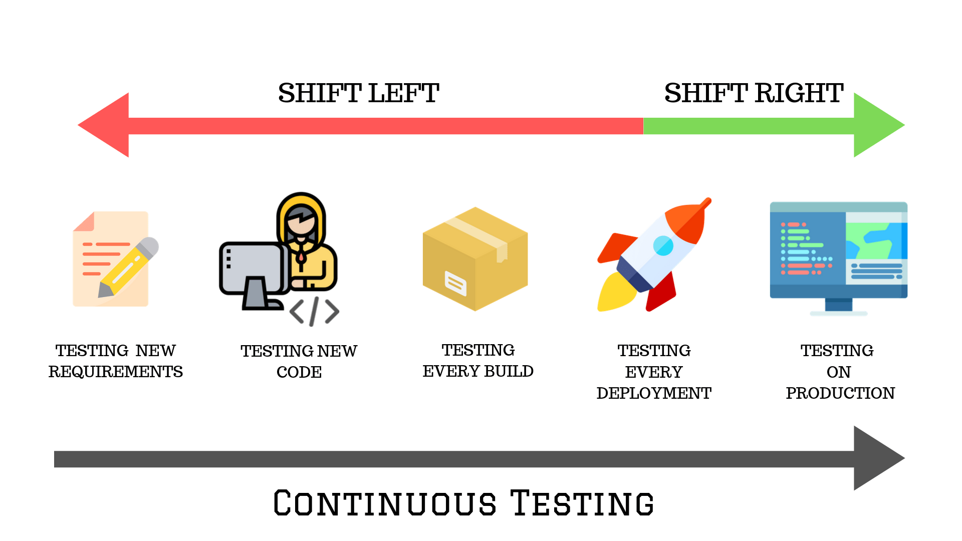

Slide 6
Where is Continouse Testing ?
Continuous Integration
Continuose Testing

Slide 7

Let’s dive into Continouse Testing

Slide 8
Shorten execution time
Feature 1
Feature 1
Test Feature 1
Feature 2
Feature 2
Test Feature 2
Test Feature
1 … 4
Feature 3
Feature 3
Test Feature 3
Feature 4
Feature 4
Test Feature 4

Slide 9
Shorten execution time
Move this things outside your tests
- Data created by API
Authentication
User creation

Slide 10
Shorten execution time
UI Test 1
One big UI test
UI Test 1
UI Test 1

Slide 11
Run in paraller
Tests
Tests
Time
Time

Slide 12
Test independencies
Test 1
Test 2
extends
Test 2
Test 1

Slide 13
Sensitive data
No hardcode of sensitive data
Inject into environment variable

Slide 14
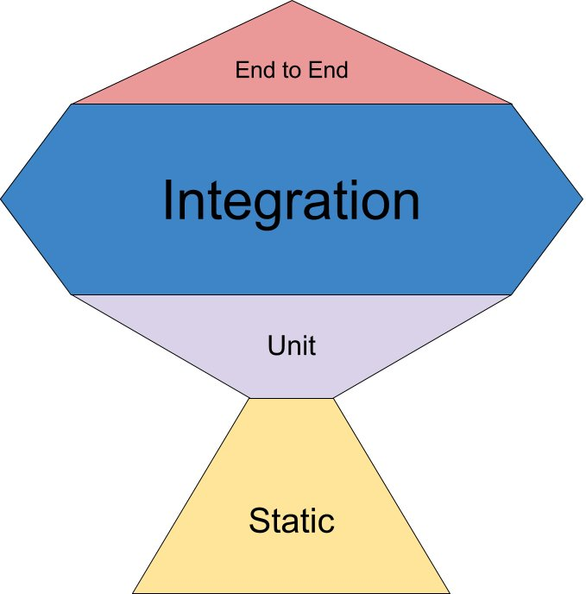
Type of tests

Slide 15
Test flow
Static
Unit
Integration
E2E

Slide 16

Reporting

Slide 17

Good practice
Run test in containers

Slide 18

Good practice
Selenium Testing on Cloud solution

Slide 19
When we can say we are Continouse Testing
Run tests
Run with schedule
Cross browser testing
Reporting
Archiving reports
Run in paraller
Tests independecies
Sensitive data managment
Shorten execution time
API Testing

